Slide 1
Gephi: An interactive network analysis and visualization tool
Michael Ginda
Senior Research Analyst
Cyberinfrastructure for Network Science Center
School of Informatics, Computing, and Engineering
Indiana University, Bloomington

Slide 2
Overview
Presentation Overview
A Brief Introduction to Networks
Downloading and Installing Gephi
Gephi’s Development Timeline
Alternatives to Gephi
Exploring Gephi’s Interface
Loading Data into Gephi
Add Plugins to Gephi
Co-Authorship Analysis with Sci2 and Gephi
Questions

Slide 3
Network
Networks

Slide 4
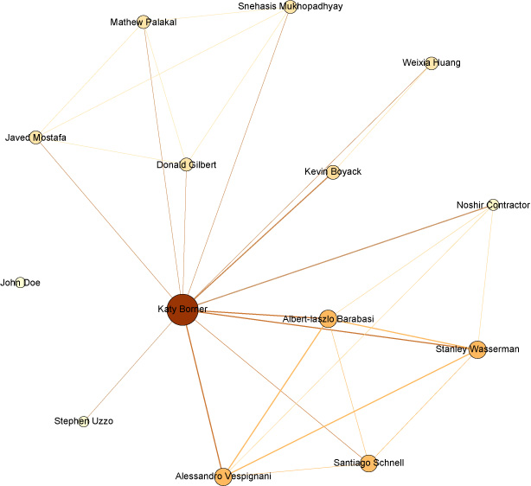
Introduction to Network Analysis
What is a Network?
Graph – network visualized
Nodes
Edges
Components
Representations
Matrices
Graphs
Edge and Node Lists
Data Formats
Tabular
XML
Text
JSON
Notes:
Make sure to explain the network visualization a bit more in-depth e.g. what do the different sizes of the nodes represent, the thicknesses of the lines etc.

Slide 5
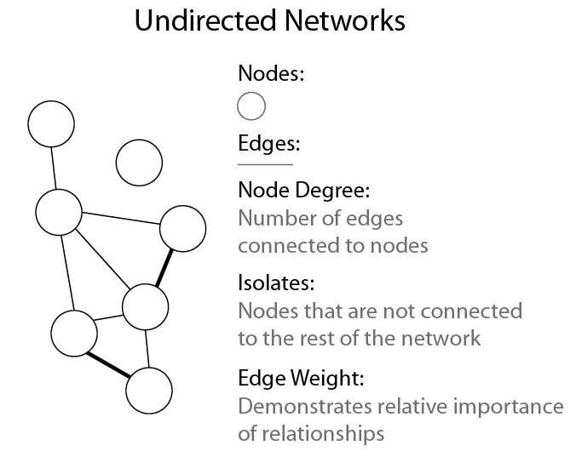
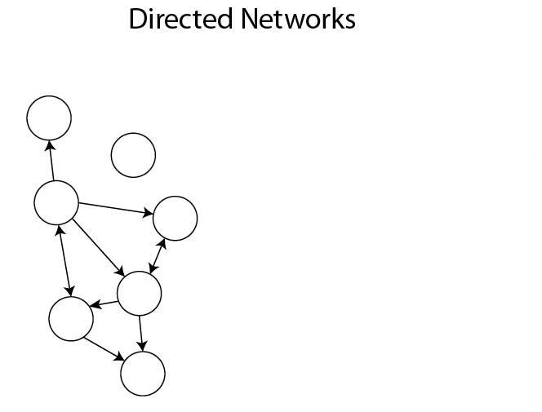
Introduction to Network Analysis
General types of networks
Edge Direction:
Directional relationship is represented by arrows
In-Degree:
Number of incoming edges
Out-Degree:
Number of outgoing edges
Other types of networks and graphs:
Hierarchical networks (tree networks)
Bipartite Networks
Multigraphs
Hypergraphs
Notes:
Incidence Matrices – relational incidence
Adjacency Matrices – node closeness/neighborhoods
Distance Matrices – node shortest path

Slide 6
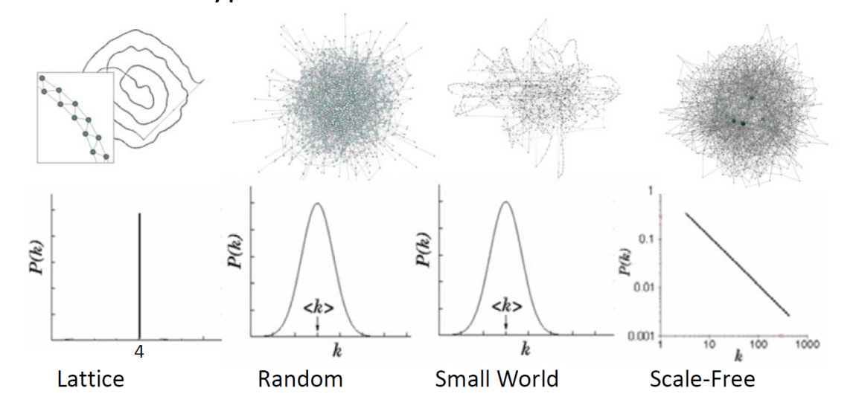
Introduction to Network Analysis
Graph Features
General Topologies
Random Graphs network
Watts-Strogatz // Small World network – gene networks, food chains, voter networks, power grids
Barabasi-Albert Scale Free network – Internet, Citation Networks, Social Network
Measurements
Node and Edge Counts
Network Components
Giant Component
Avg. degree distribution
Avg. Clustering
Density
Avg. Path Length
Diameter

Slide 7
Introduction to Network Analysis
Node Metrics
Degree
Isolate nodes
Degree Centrality
Betweenness
Closeness centrality

Slide 8
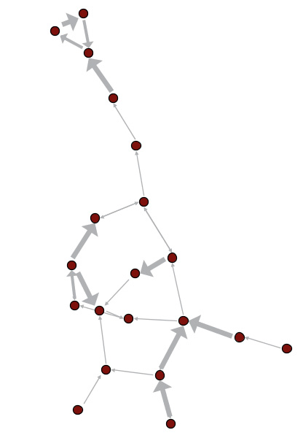
Introduction to Network Analysis
Graph Metrics - Edges
Shortest paths – shortest distance between two nodes
Weight – strength of tie
Directionality – is the connection one-way or two-way (in-degree vs. out-degree)?
Bridge – deleting would change structure

Slide 9
Gephi
Gephi Network Analysis and Visualization Tool

Slide 10
"…for many users Gephi is confusing. Geeks of a masochistic tendency may love the tool as a result of digital Stockholm Syndrome, but the bulk of users that could benefit from Gephi find it to be confusing and opaque."
From <https://gephi.wordpress.com/2015/06/02/improving-the-gephi-user-experience/>
Notes:
7/6/2012 and 8/7/2013

Slide 11
A brief overview of the features…
Exploratory Network Analysis
Static and Dynamic Networks
Visualization
Node & Edge Size, Color, & Labels
Layout algorithms
Filtering and Partitioning
Cluster Analysis
Loads and exports a variety of network formats
Streaming Graphs
Extensible Plugin Library
Save raster and vector graphics
Open source tool
Gephi GitHub
Large user community

Slide 12
Downloading and Installing Gephi
Hardware and System Requirements
500 MHz CPU + 128 MB RAM + OpenGL 1.2
Requires Java version 7 and later
Network size (nodes + edges) | ~Memory suggested
~1000 | 128mo
~10,000 | 512mo
~100,000 | 2go
~1M | >8go
Table 1: Recommended Gephi Memory Settings based on the size of the network being analyzed and visualized.

Slide 13
Downloading and Installing Gephi
Downloading Gephi 0.9.0

Slide 14
Gephi Troubleshooting
Gephi Troubleshooting
Instructions for Installing Gephi
Installing upgrades of Gephi requires uninstalling the prior version of the tool.
Make sure Java 7 or newer us installed on your machine.
JVM Creation failed – see trouble shooting instructions here.
Fixing Graphics Cards Issues - Gephi takes its performance by using 3D rendering and applying video games techniques in its built-in graph visualization engine; some issues be caused by particular hardware and/or configuration.

Slide 15
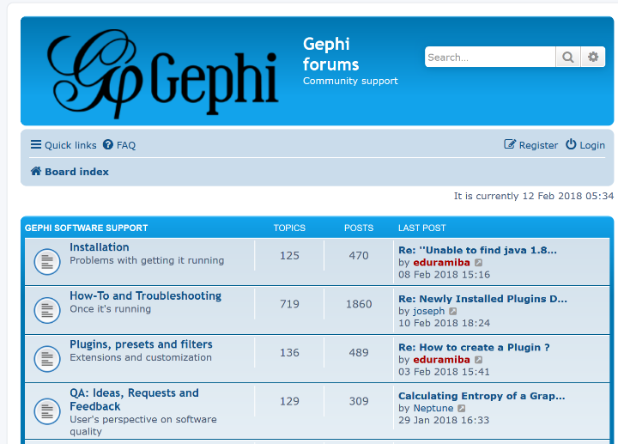
Gephi User Resources
Gephi Resources
Gephi Support - https://gephi.org/users/support/
Bug Reporting - https://github.com/gephi/gephi/issues
Gephi Tutorials - https://gephi.org/users/
Gephi User Community
Volunteer Opportunities https://gephi.org/users/contribute/
Developers - https://gephi.org/developers/
User Support – http://forum-gephi.org/

Slide 16
Gephi’s Development Timeline
Gephi’s Development
Gephi is an open-source network analysis and visualization software package written in Java on the NetBeans platform. The first version of Gephi was initially released in 2009. Gephi was initially developed by students of the University of Technology of Compiègne (UTC) in France.
Bastian, M., Heymann, S., Jacomy, M. (2009). Gephi: An open source software for exploring and manipulating networks. AAAI Publications, Third International AAAI Conference on Weblogs and Social Media, retrieved 2011-11-22. https://www.aaai.org/ocs/index.php/ICWSM/09/paper/view/154
In 2013, the core Gephi development team began a years long process of redesigning the graphical core that powers the tool, as well as improve the user interface of the tool.
Version 0.9.0 launched in 2015. Prior to this release, users were facing compatibility issues with Java and memory usage issues. The latest update for the tool was in September 2017 with release of Gephi 0.9.2.
The transition between versions 0.8.2 and 0.9.0 cause compatibility issues with plugins and errors with networks using older data format specifications.

Slide 17
Alternatives to Gephi
Alternative Tools for Network Analysis
Pajek
GUESS
CytoScape
UCINET
Sci2
VOSViewer
R packages
SNA, iGraph, ggnets
Python Libraries
NetworkX, iGraph,
JavaScript
networkD3.js, ndtv, visNetwork, angular etc.

Slide 18
Network Visualizations - Considerations
When visualizing networks, remember that there is no undo or ctrl-z.
If you make a mistake or forget to save your settings, no worries, just…
Re-Apply,
Reset, or
Reload

Slide 19
The Gephi Interface

Slide 20
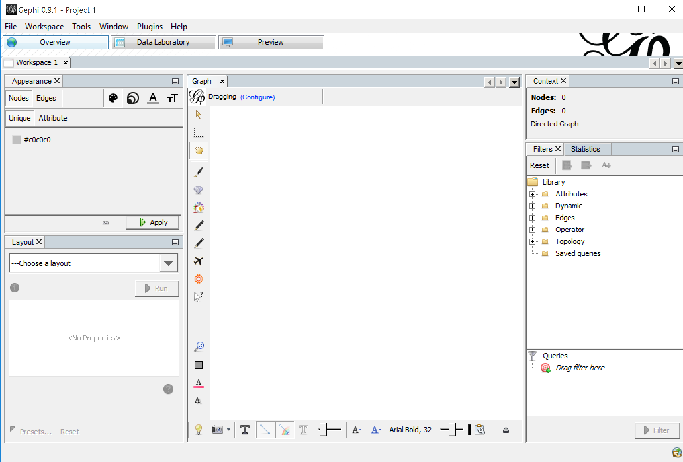
Running Gephi
On your desktop or applications directory, find the Gephi icon and run the tool.

Slide 21
Gephi Interface
Gephi tool layout and visualization framework: user is free to rearrange the environment, move panels, show/hide windows, etc.
The GUI is set by default for three task families grouped as Overview, Data Laboratory and Preview.
Overview: graph analysis and manipulation mode.
Data Laboratory: data tables.
Preview: visual tuning before vectorial/raster export.
(https://github.com/gephi/gephi/wiki/GUI)

Slide 22
Gephi Interface: Overview Pane
Pane lets user control size and color of nodes and edges based on network partitions, node and edge rankings, and clustering results and scale values to splines.
Tools let you select nodes and edges, and color nodes and edges based on paths.
Basic network stats and filter stats.
Pane contains network statistical analysis algorithms. And network filters for subsets and partitioning based on node and edge variables
Pane lets user select a network layout, and adjust the layout algorithm parameters
These tools let you re-center the network, and rest color, size and label attributes.
Tools let you adjust network labels attributes, and take snapshots of the graph viewer.
Navigate workspaces

Slide 23
Gephi Interface: Data Laboratory
Select the node or edge lists data, and configure the sheet
Add node edges, imports data (nodes and edges lists) to create new networks in blank workspaces, and exports data tables for a network.
A REGEX filter for nodes and edges table columns in data table.
Converts data fields from standard to dynamic (temporal data fields)
Create columns fitting Boolean criteria and regex functions. Useful for filtering.
Adds & Merge data column tools
Column editing tools

Slide 24
Gephi Interface: Preview
Preset layouts, and a layout configuration saving feature
Node border and opacity attributes
Node labels attribute selection, including label size, color, length, etc.
Edge size, color, type, and opacity and scaling attributes.
Edge label attributes.
Refresh and exporting the Preview tools, and zoom resets.

Slide 25
Loading Data into Gephi

Slide 26
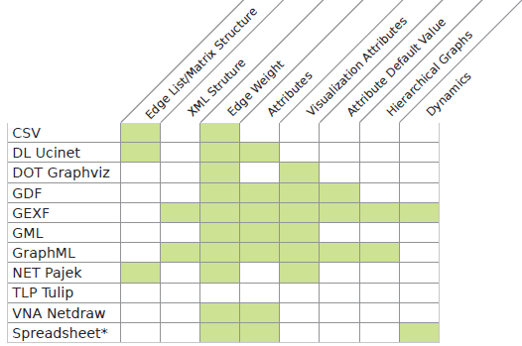
Creating a Visualization in Gephi
How to get data into Gephi?
Loading the data in manually through user interface
Overview Window
Load in pre-formatted network
Data Laboratory
Load in Node and Edge Lists CSV files
Stream in data using Gephi graph API using plugins
Pass graph data to Gephi using graph API
Sci2 network extraction to Gephi
Table 2: Network data formats Imported by Gephi

Slide 27
Creating a New Project
Create a New Project
After you’ve started Gephi, you will need to create a new project.
You can select new project from the file menu or select Ctrl+Shft+N on your keyboard.

Slide 28
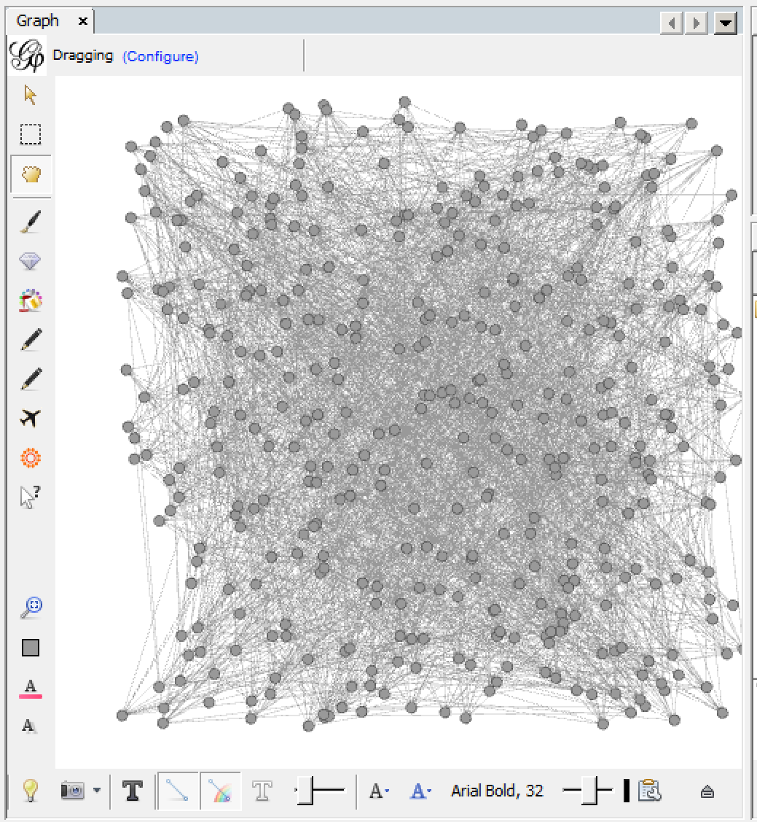
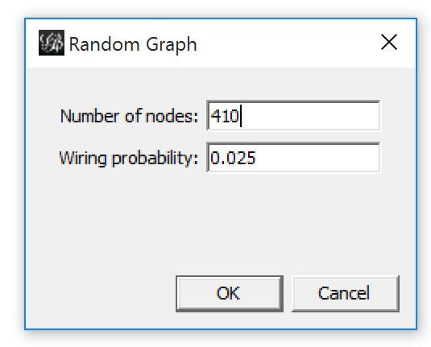
Loading a Random Graph
Loading Data
Creating sample networks
Random Graphs
Dynamic Networks
Multigraphs

Slide 29
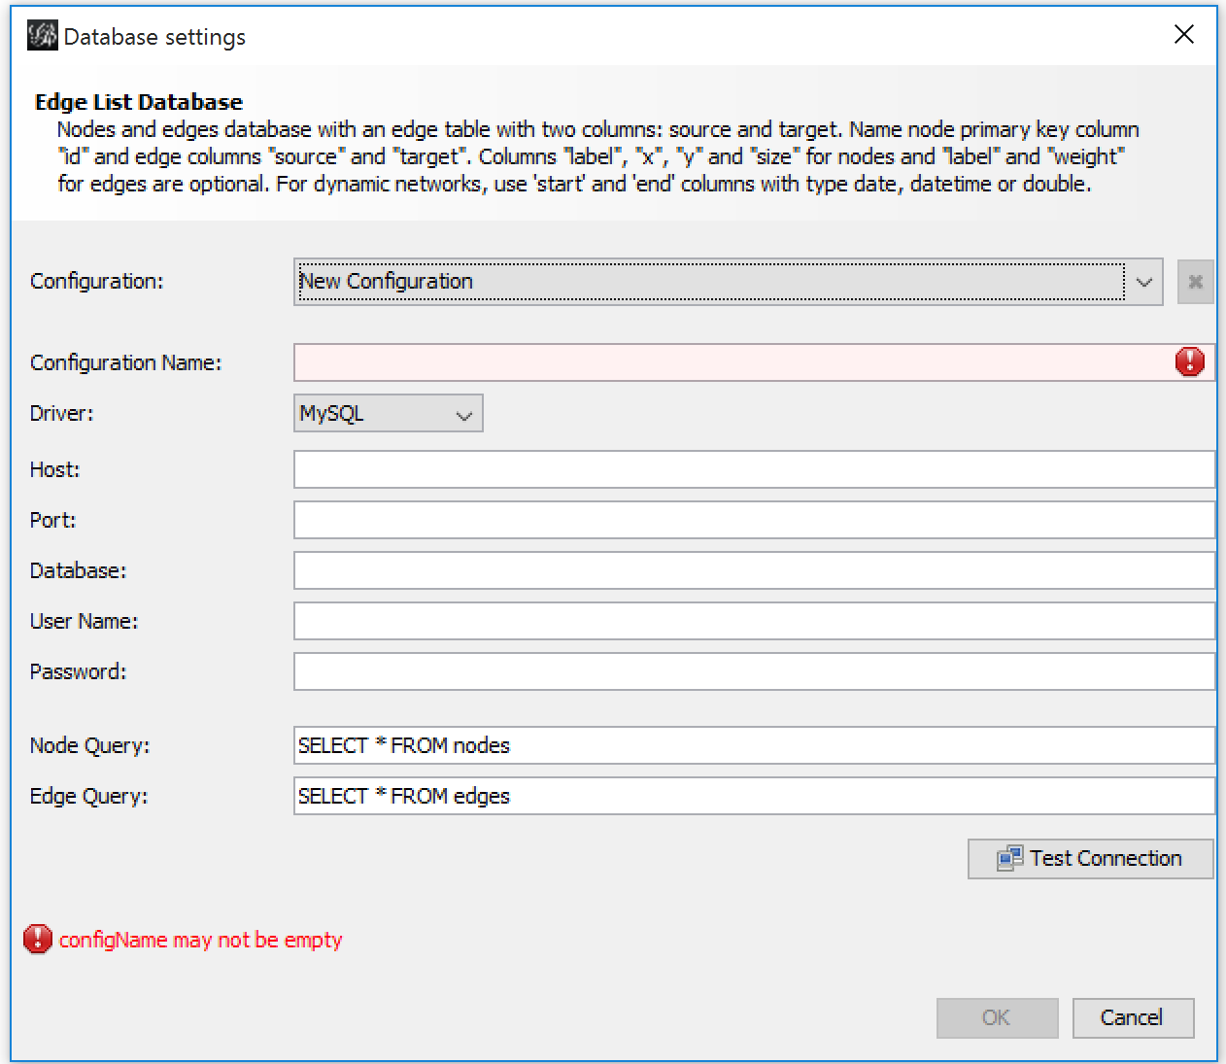
Streaming in an edge list to Gephi
Connecting to a Database
While not the focus of this presentation, documentation for import a network edge list database is found on the Gephi GitHub.

Slide 30
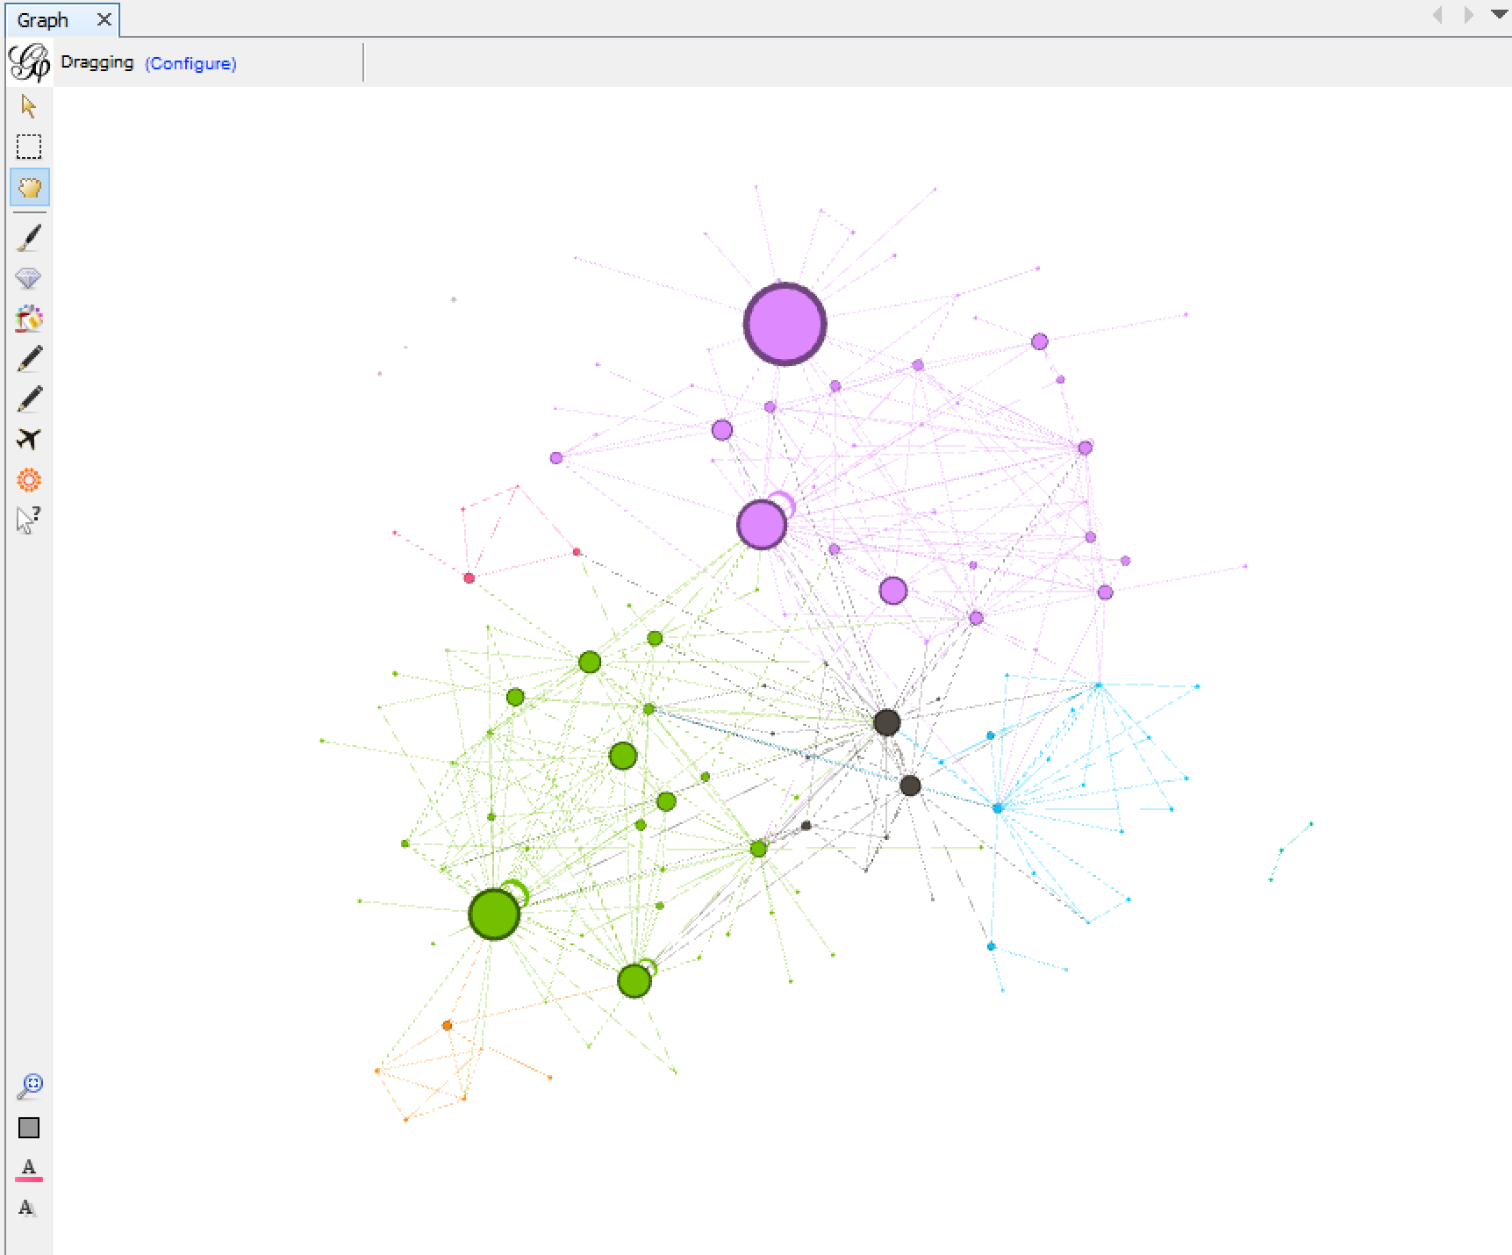
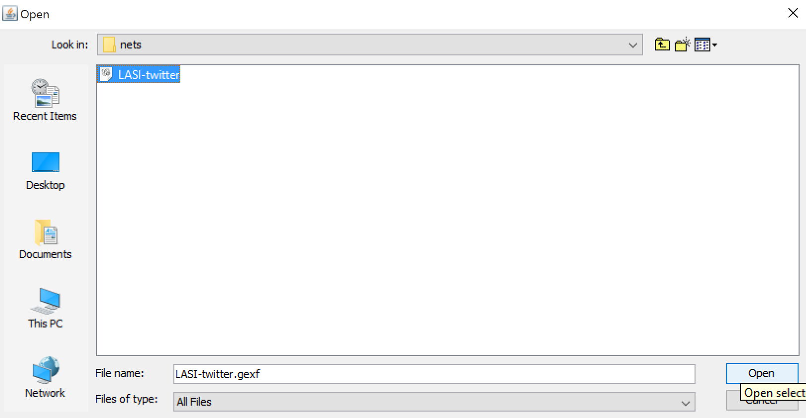
Loading in Data through GUI
Loading a network data file
To load a formatted network file into Gephi, in the File menu select “Open…” or Ctrl+O on the keyboard.
LASI16.gexf example shown.

Slide 31
Loading a Network from Spreadsheets
Loading a Network from Spreadsheets
Gephi can import networks from tabular data (as CSVs), if you can provide a node* and edge list using Gephi’s Import Spread Sheet tool.
(If using) Node list file should contain an “ID” field that references the values found in the “Source” and “Target” fields of the edge list.
Edge list must have a “Source” and “Target” field; these are mandatory and can't be deselected
An Edge List “Weight” field with a numeric data type will be automatically recognized by the import wizard as well
If a column name already exists in the project space you will be able to use it, but the data type of the column is already set and can't be changed, and
Imported data will be parsed to fit the existing column type
Written instructions can be found here: https://github.com/gephi/gephi/wiki/Import-CSV-Data

Slide 32
Loading a Network from Spreadsheets
1
1) The spreadsheet import tool may be engaged from the file menu and selecting “Import spreadsheet…” or via 2) the Data Laboratory window’s “Data Table” view by selecting “Import spreadsheet…” button.
2

Slide 33
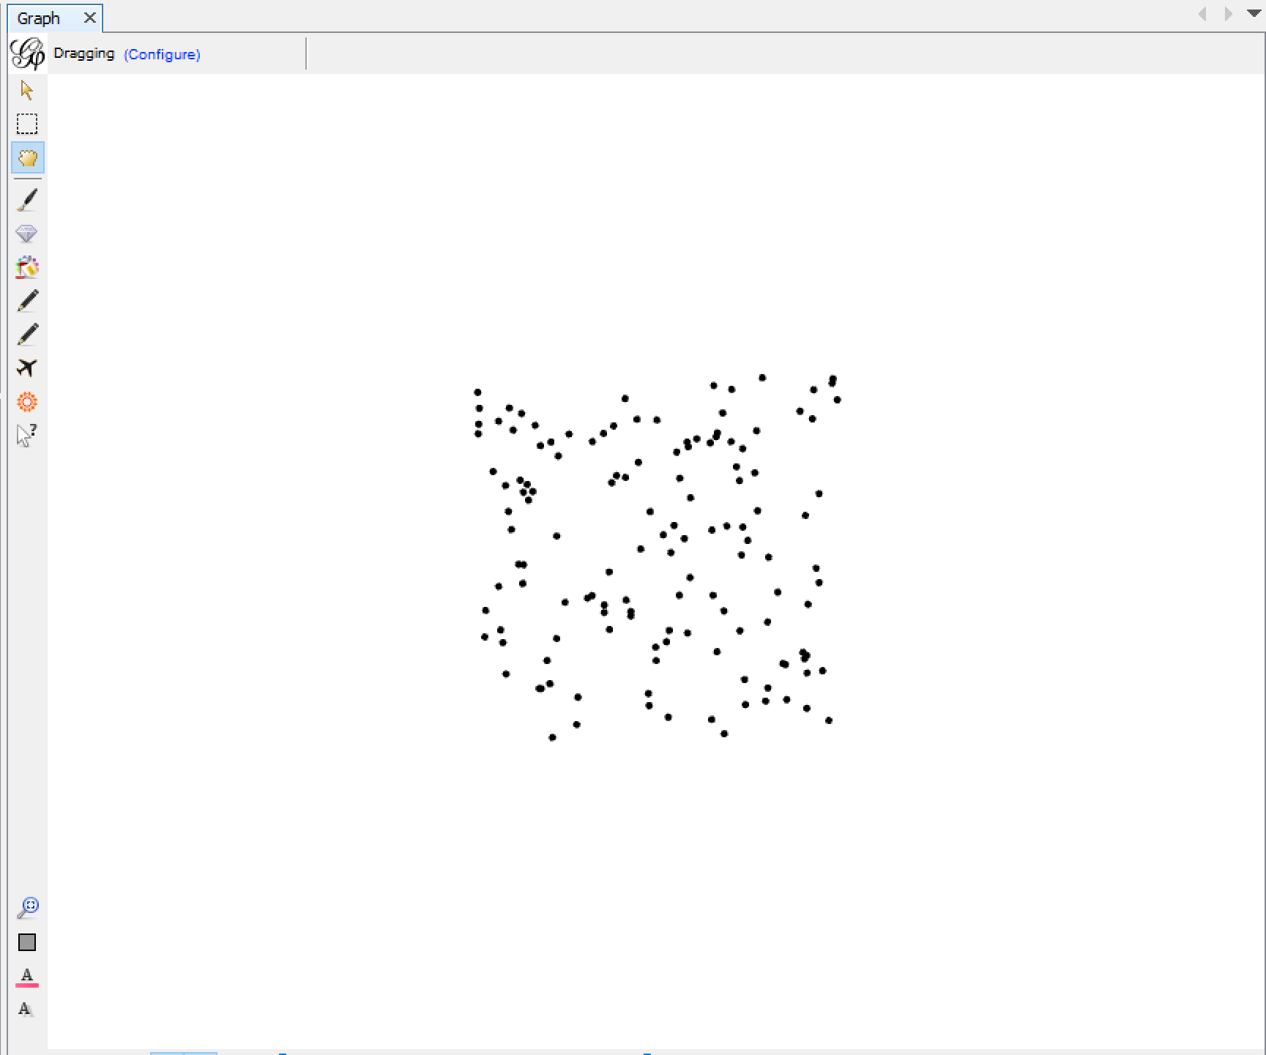
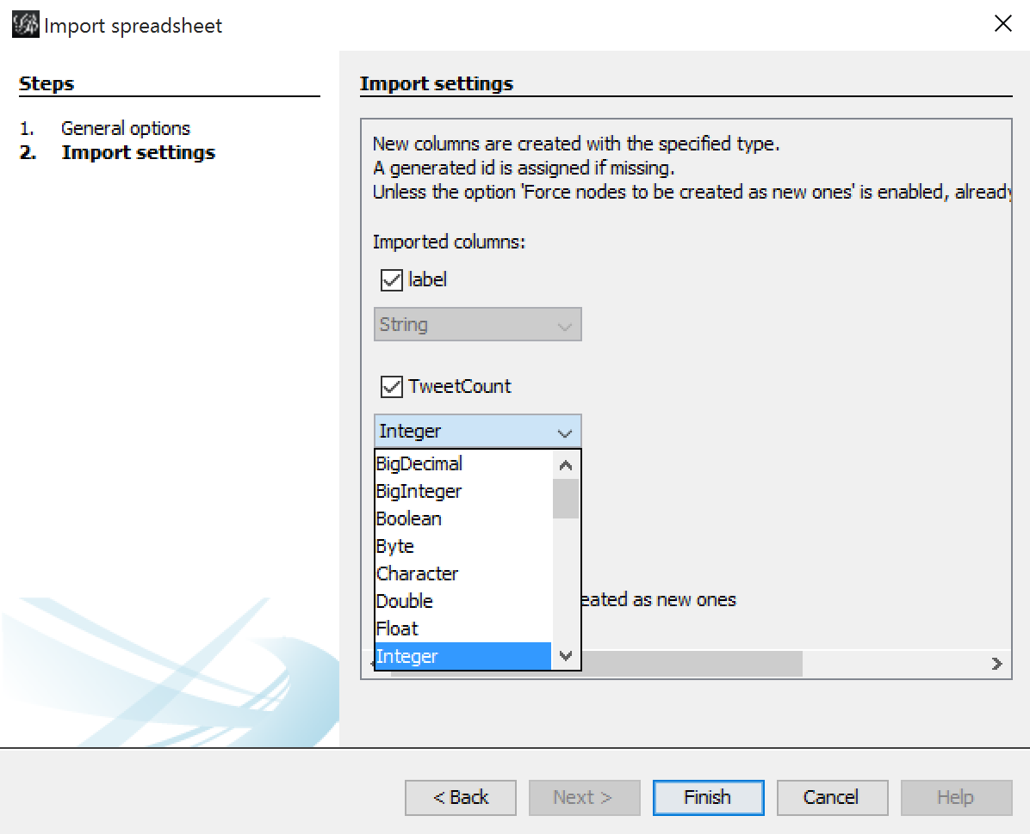
Loading a Network from Spreadsheets
When creating a network, it is easier to start with the node list first.
Choose the node list CSV file to import (LASI-Nodes.csv)
Make sure the field As Table is set to “Nodes table”, and select Next.
The columns will be identified in the table, allowing a user to select the data type, then select Finish.
except for preset fields like id and label
for column names that have been encountered before
A field may be unselected by the check box next to the column name.
Looking at the Overview window, shows that the nodes have been loaded.

Slide 34
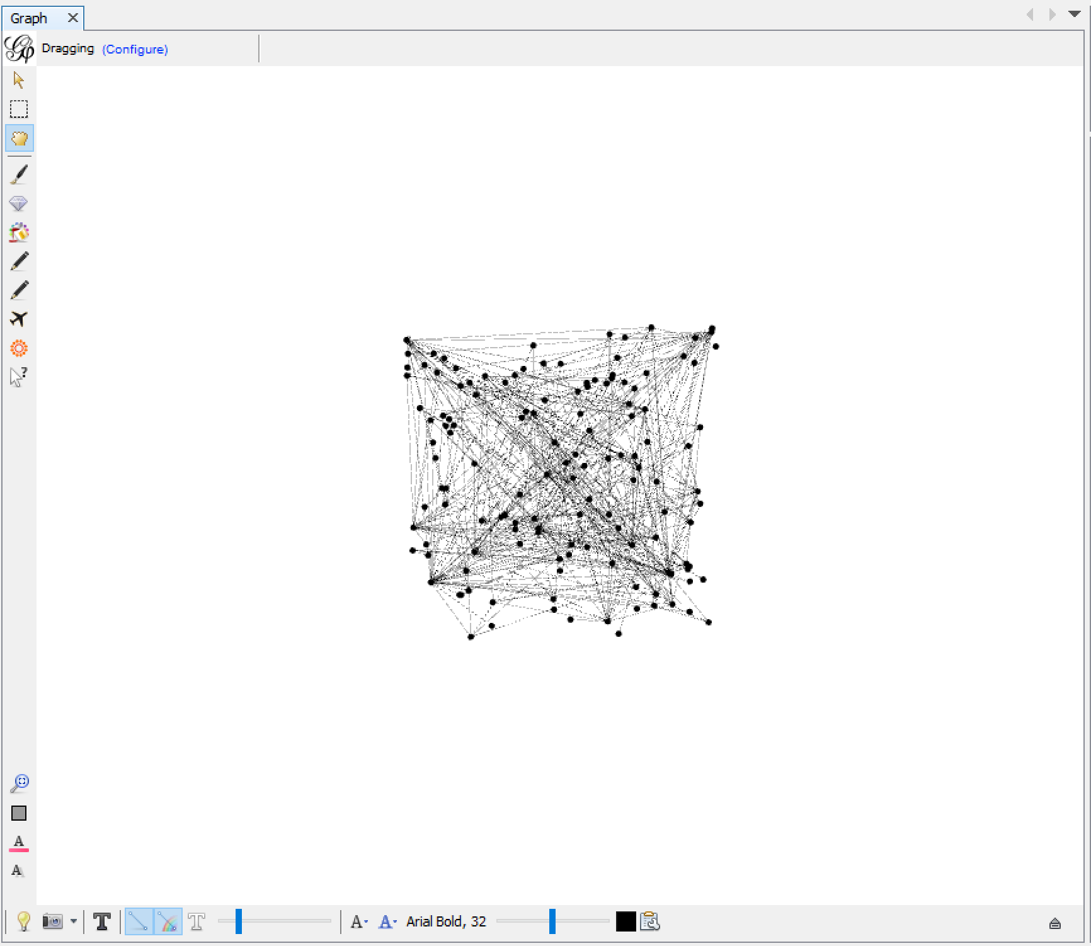
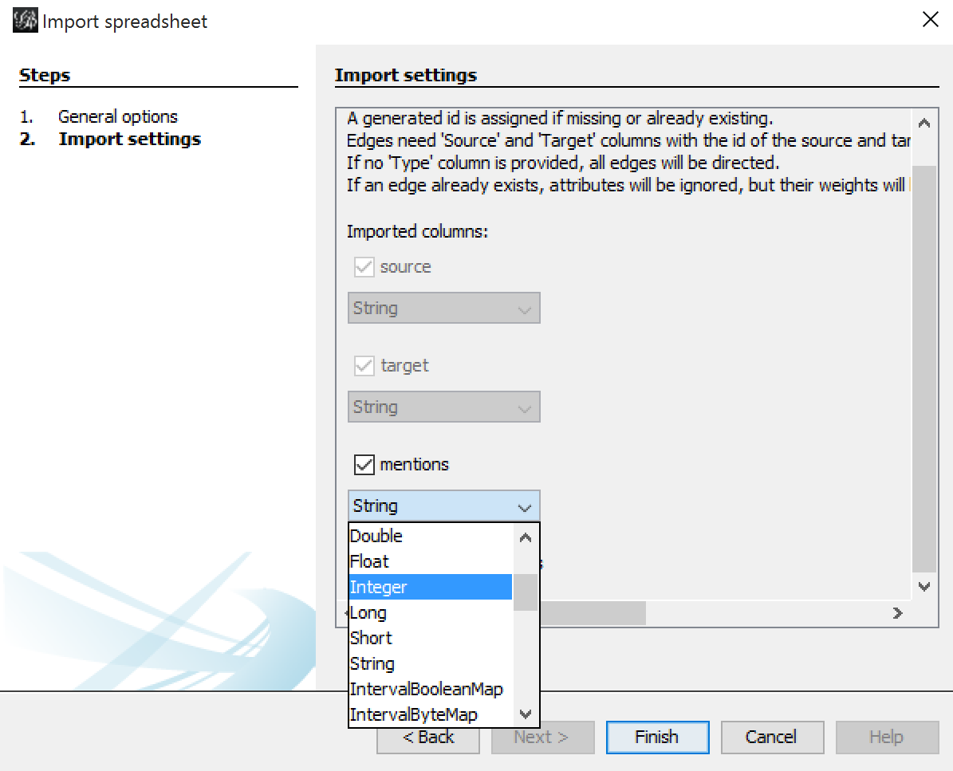
Loading a Network from Spreadsheets
Back in the Data Laboratory, select the “Import spreadsheet…” button, and load in the edge list.
Choose the edge list CSV file to import (LASI-Edges.csv)
Make sure the field As Table is set to “Edges table”, and select Next.
The columns will be identified in the table, allowing a user to select the data type, then select Finish.
except for preset fields like source, target, label, and weight.
for column names that have been encountered before
a field may be unselected by the check box next to the column name.
Looking at the Overview window, shows that the edges have been loaded.

Slide 35
Gephi Plugins

Slide 36
Finding and Adding Plugins to Gephi
Gephi is extensible to user created plugins, that allow users to add new analysis, layout, export features to Gephi. Users can download plug-ins manually (https://gephi.org/plugins) or through the user interface in Gephi.
Make sure that plugins are compatible with the version of Gephi that you are running.

Slide 37
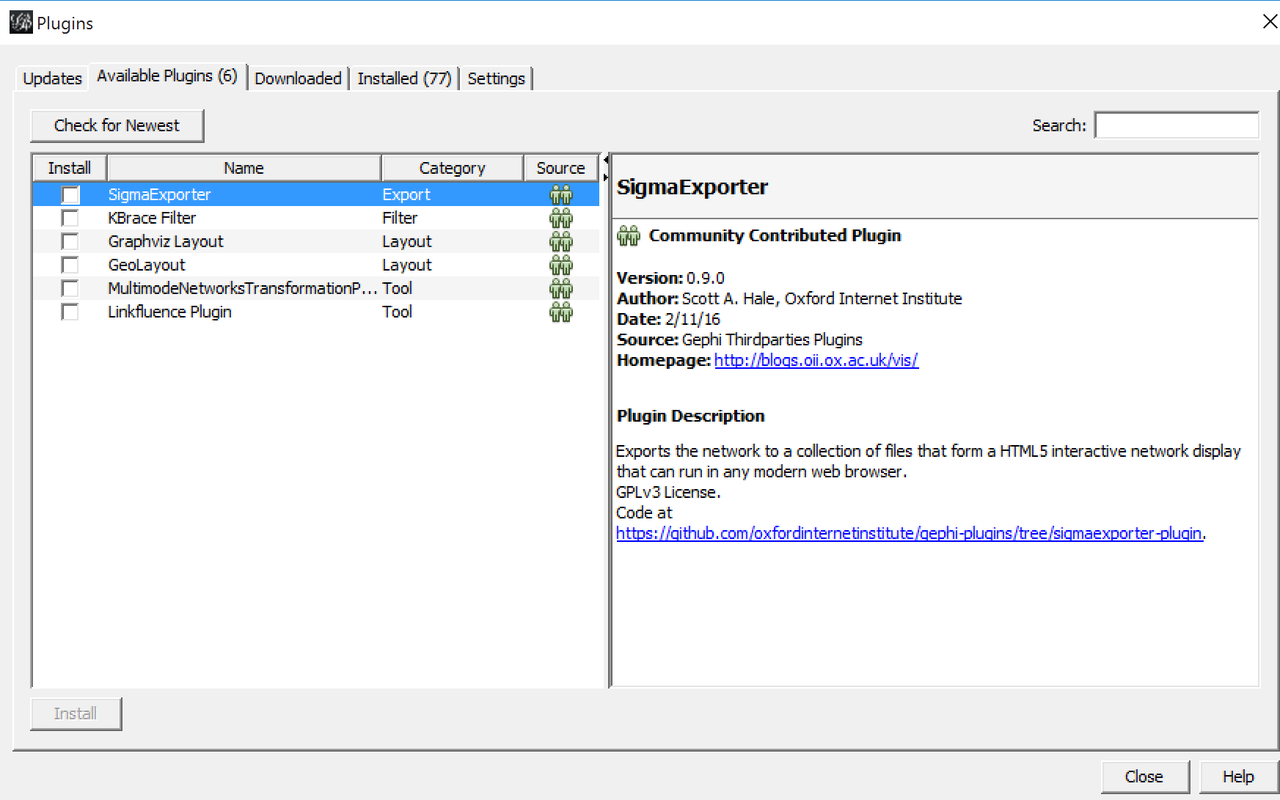
Finding and Adding Plugins to Gephi
Adding plugins through the user interface is done through the Tool menu, select “Plugins” from the menu. A new window will pop-up, giving you the option to:
install updates to existing plugins,
check for plugins that are listed as available for your release, or
manually add plugins downloaded from Gephi’s plugin site; and
see plugins that are install (which can be activated or deactivated) and see settings.

Slide 38
Co-Authorship Analysis in Gephi

Slide 39
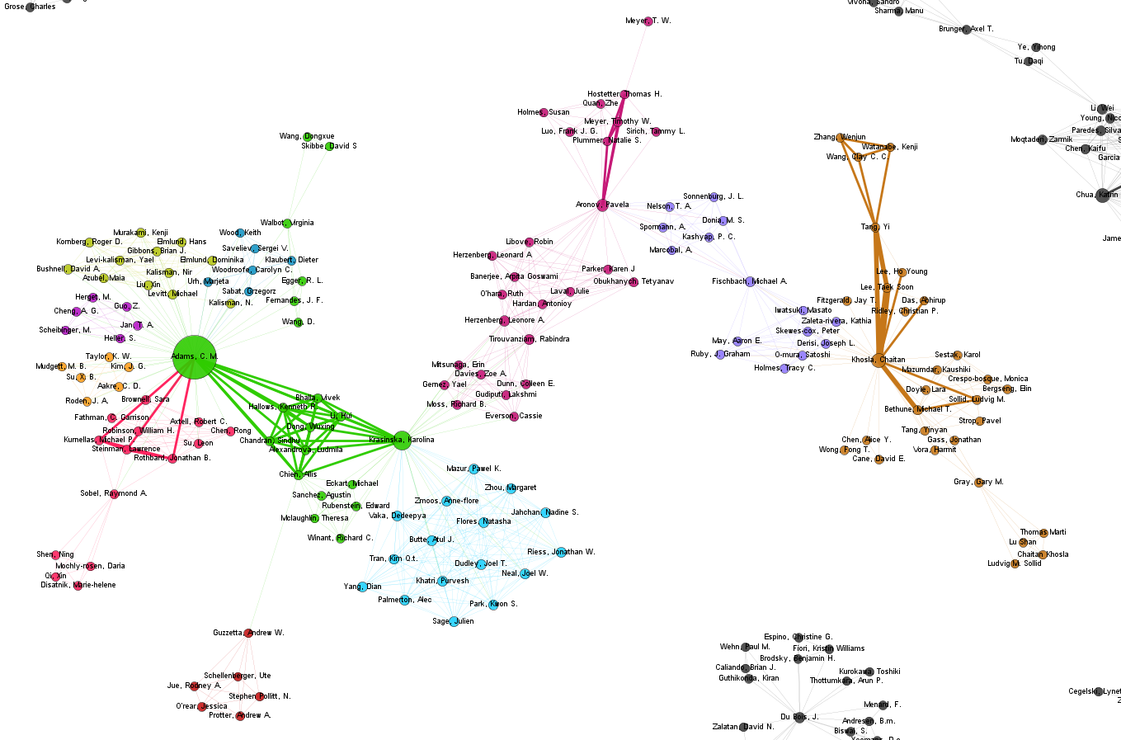
Co-Author Network Analysis
What is the purpose of looking at co-author networks? What can they tell us?
This is a visualization of a citation dataset from a researcher that administers a Core research facility at Stanford University.
The objective of the researcher who provided this data set was to understand
Which researchers using her lab were publishing articles?
Which researchers collaborate frequently in the facility?
Who has the most citation impact?

Slide 40
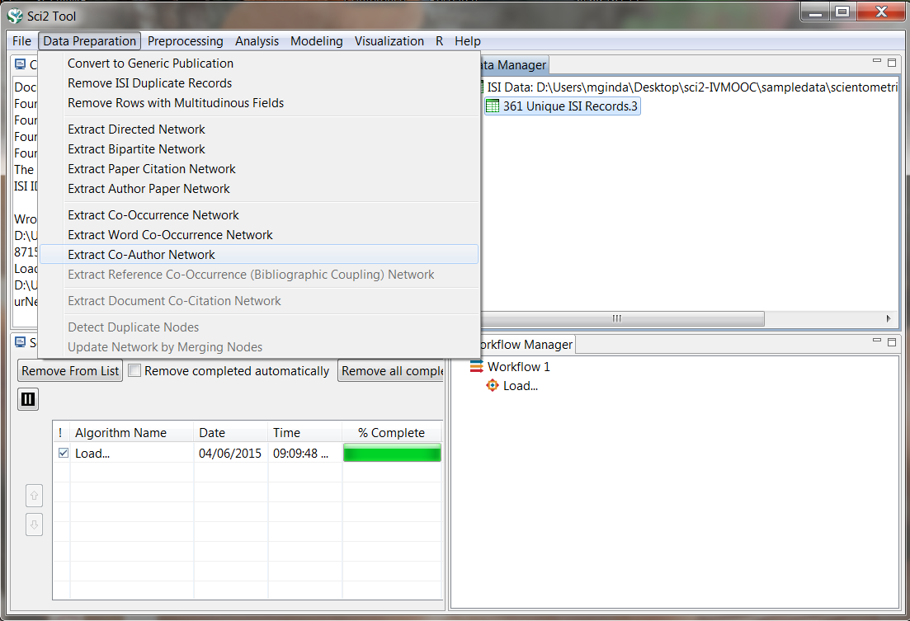
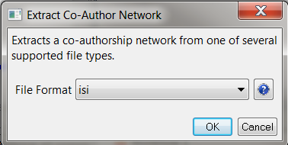
Co-Author Network Analysis
Load FourNetSciResearchers.isi located in Sci2 Directory
Select the data 361 Unique ISI Records in the Data manager and the algorithm Extract Co-Author Network in the Data Preparation menu.
A pop-up window will appear; select the format ISI.

Slide 41
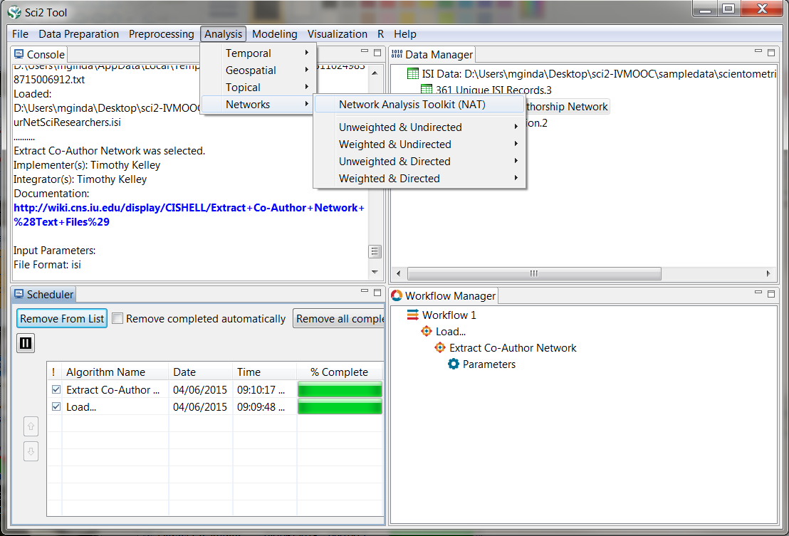
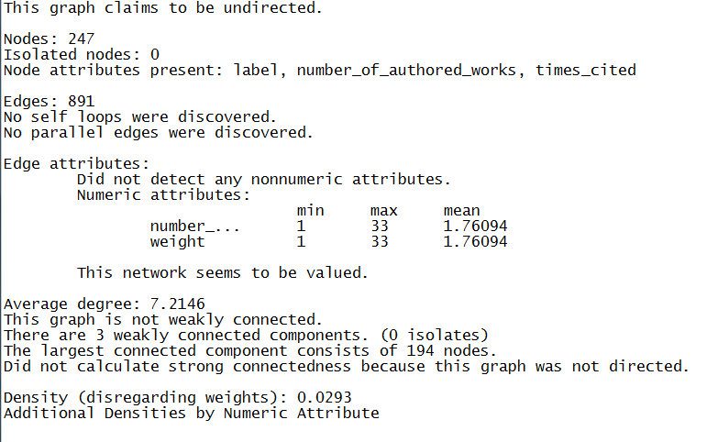
Co-Author Network Analysis
After creating your initial network, it is a good idea to get a brief overview of its statistical properties.
Sci2 has a built-in analysis toolkit to perform these basic statistics.
Select the network output file in the data manager, and then in the menu select Analysis -> Networks -> Network Analysis Toolkit (NAT)
The output should read:

Slide 42
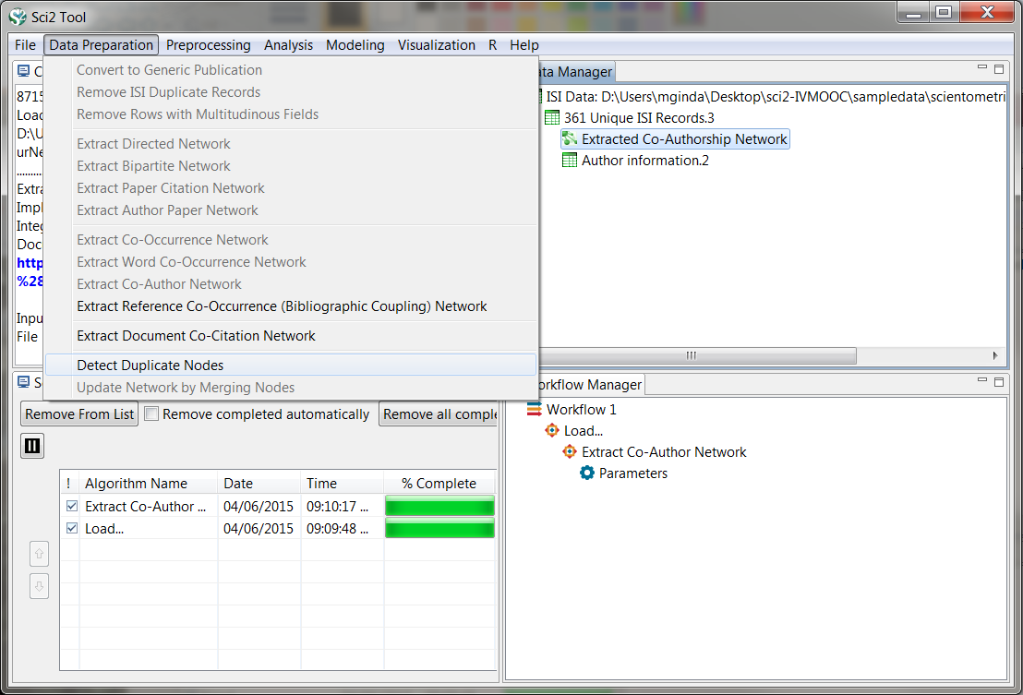
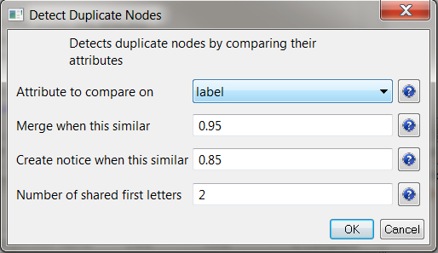
Co-Author Network Analysis
One of the challenges of a co-author network is determining if your data set has duplicate names (e.g. John P. Smith and J P Smith).
To detect duplicate nodes, we will want to select the network in the data manager, and then select Data Preparation -> Detect Duplicate Nodes.
A pop-up window will appear, for this demo we will keep the input parameters.

Slide 43
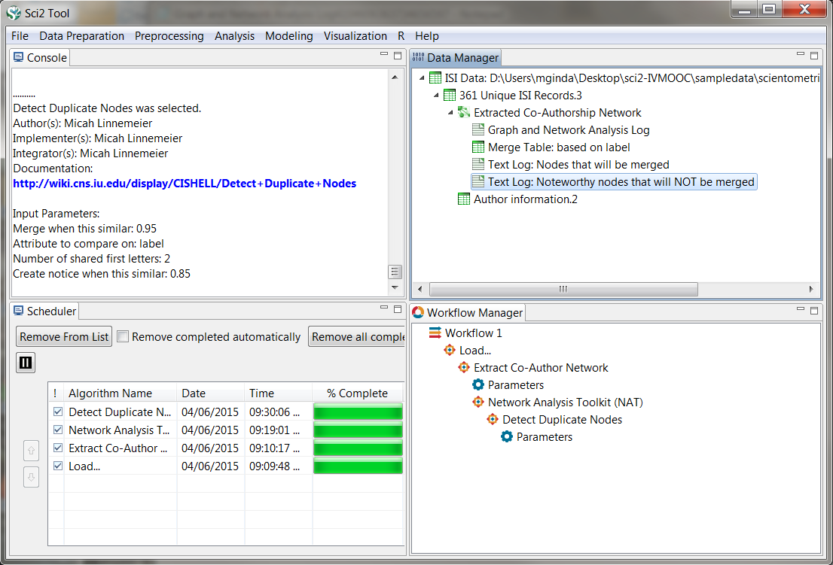
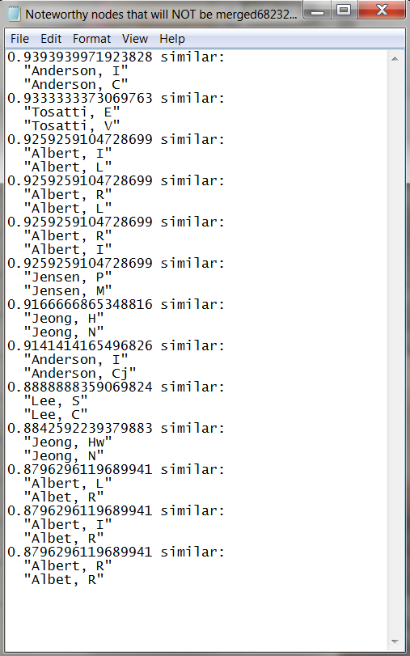
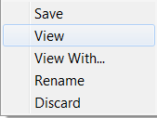
Co-Author Network Analysis
Let’s look at the output file Text Log: Noteworthy nodes that will NOT be merged.
Right click the file in the data manager, and select view or view with… which will allow you to open the file in a text editor like notepad.
We can repeat this process
with the file listing nodes that will be merged.

Slide 44
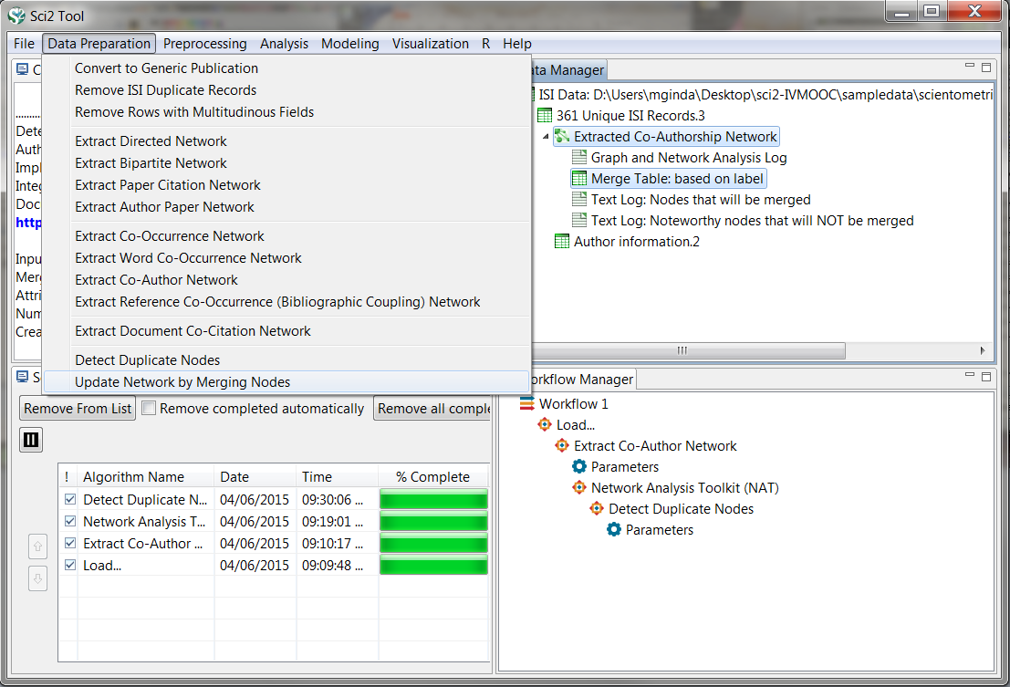
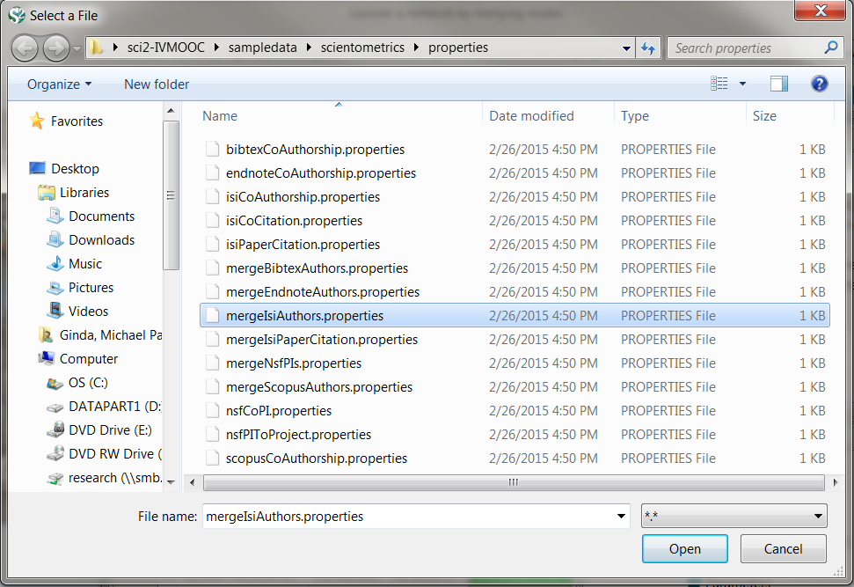
Co-Author Network Analysis
After we’ve identifying our duplicate nodes, we need to merge these duplicates.
Select the network file and the Merge Table: based on label file in the data manager, and then select Data Preparation -> Update Network by Merging Nodes
A box will appear that allows us to use an aggregation function file (property files). Select browse, and navigate to the Sci2 directory sampledata -> scientometrics -> properties and select MergeIsiAuthors.properties
Select open, and then OK.

Slide 45
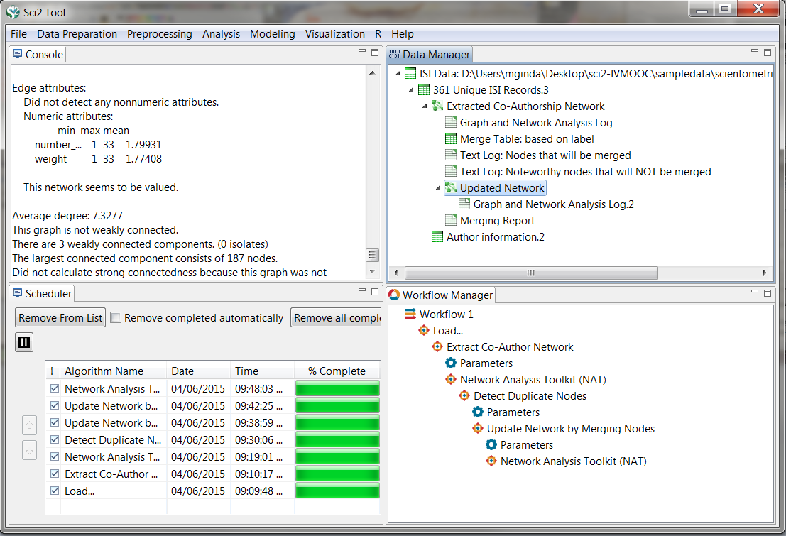
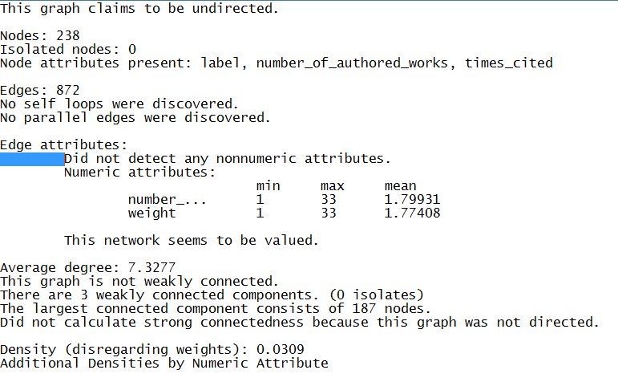
Co-Author Network Analysis
We’ve now updated out network, so lets re-run the network analysis toolkit algorithm to see how our network has been effected by our work.
What changes do you notice to the network statistics?
Original Network
Revised Network

Slide 46
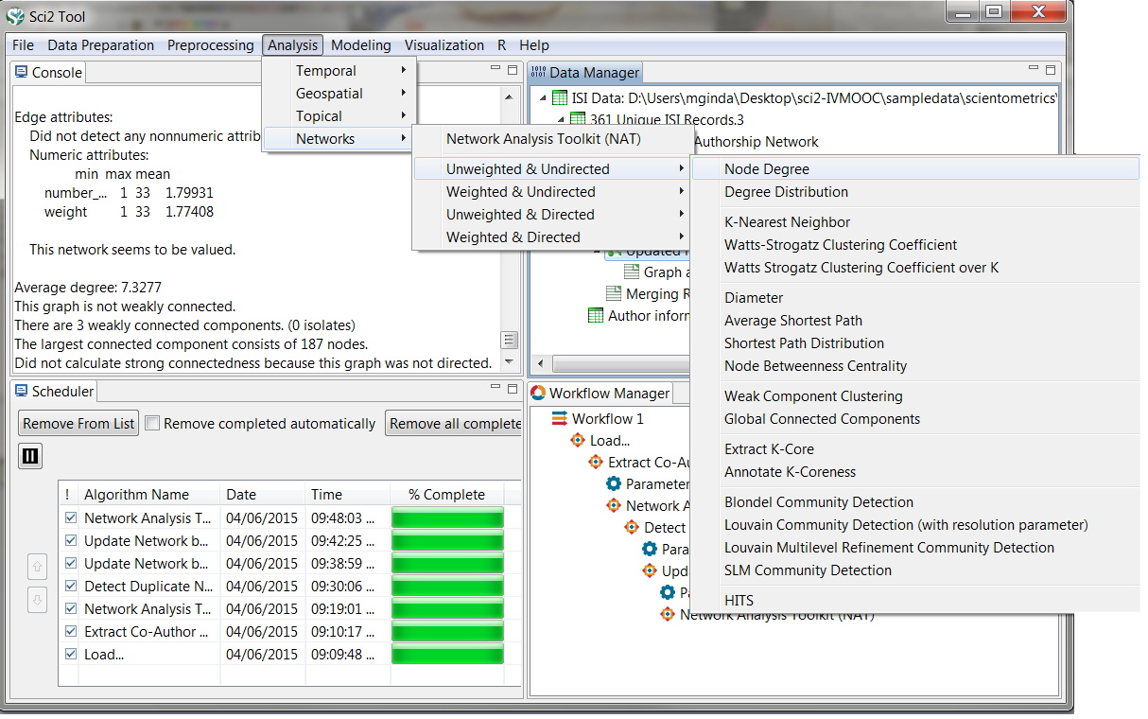
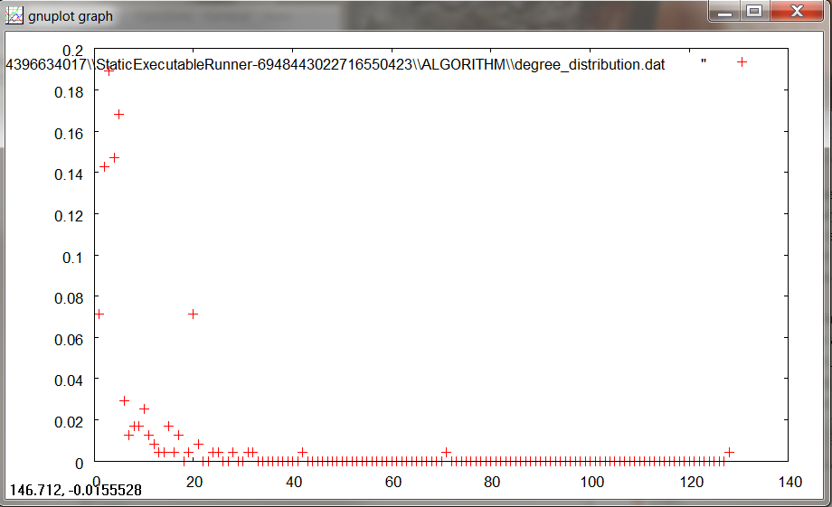
Co-Author Network Analysis
Let’s start to analyze the updated network. To start, lets find the degree for each node.
Select the updated network in the data manager, and then select in the menu Analysis -> Networks-> Unweighted & Undirected -> Node Degree
A new network file will be output that has appended a degree to each node in your network file.
To see the distribution of node degrees, use the same menu path above, except you will need to select algorithm Degree Distribution. A pop-up window will appear, for now, just hit OK. Two data files will appear, we’ll select the first.
To visualize this file, select Visualization -> General ->GnuPlot

Slide 47
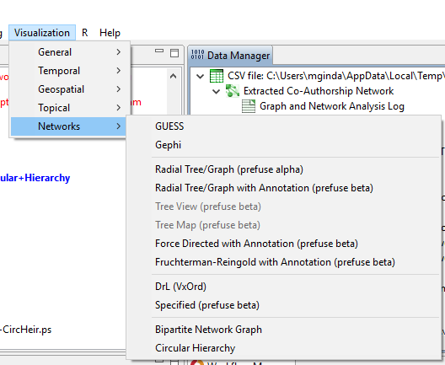
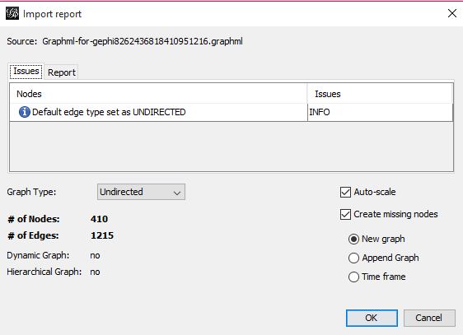
Co-Author Network Visualization in Gephi
Next we will visualize the network in Gephi.
Navigate to Visualization > Networks > Gephi.
The algorithm is a bridge that passes the network data to Gephi. The program will automatically start. The tool produces an Import Report. It lets you select the network type, gives load errors, etc.
Next, is a brief walk through of Gephi’s three main sections, and outline various functions and tools available.

Slide 48
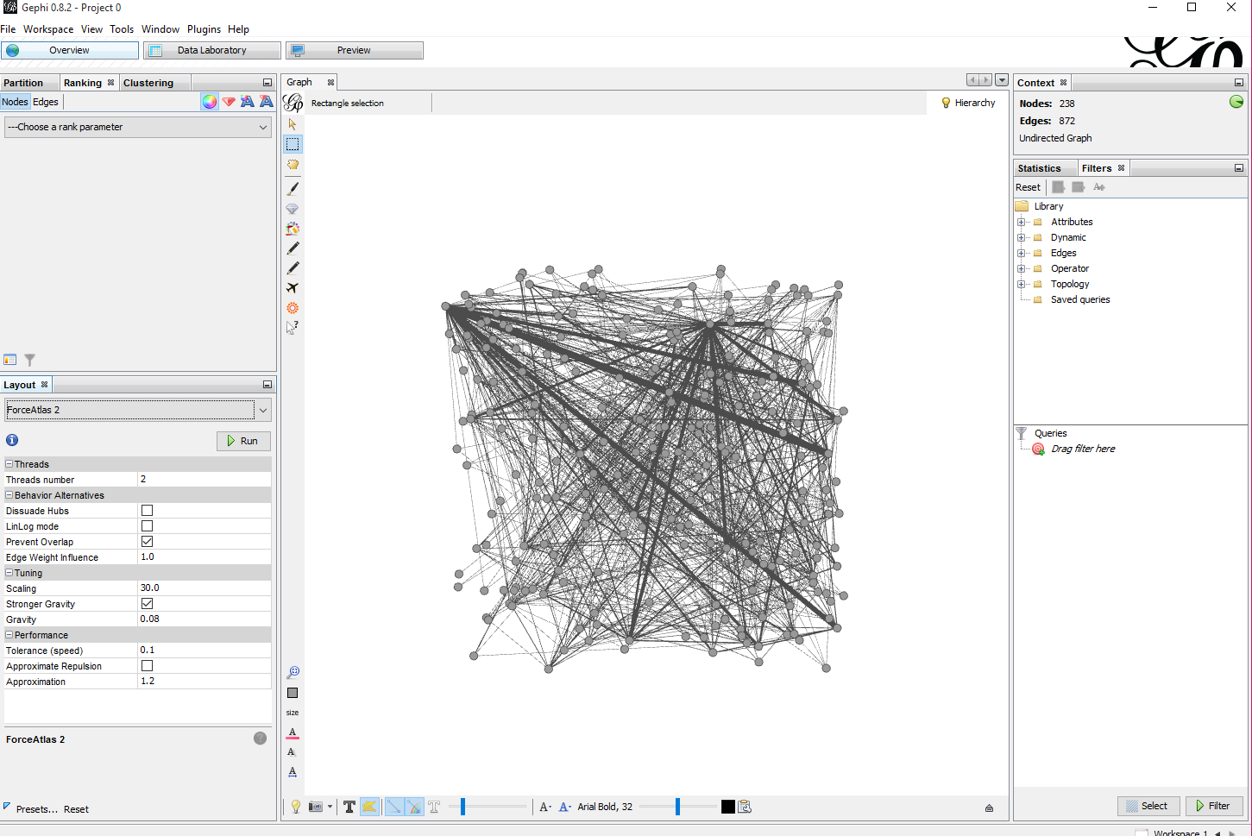
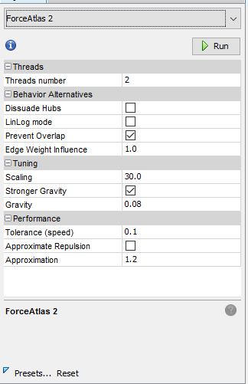
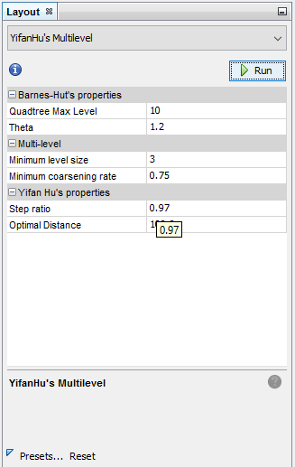
Gephi: Initial Layout of Network
Now we can start an visualization and analysis of the network.
First we will adjust the layout of the network.
From the layout pane, select the “ForceAtlas2” layout algorithm and enter the following parameters, and then select “Run”.
You may also select YifanHu’s Multilevel force network layout.

Slide 49
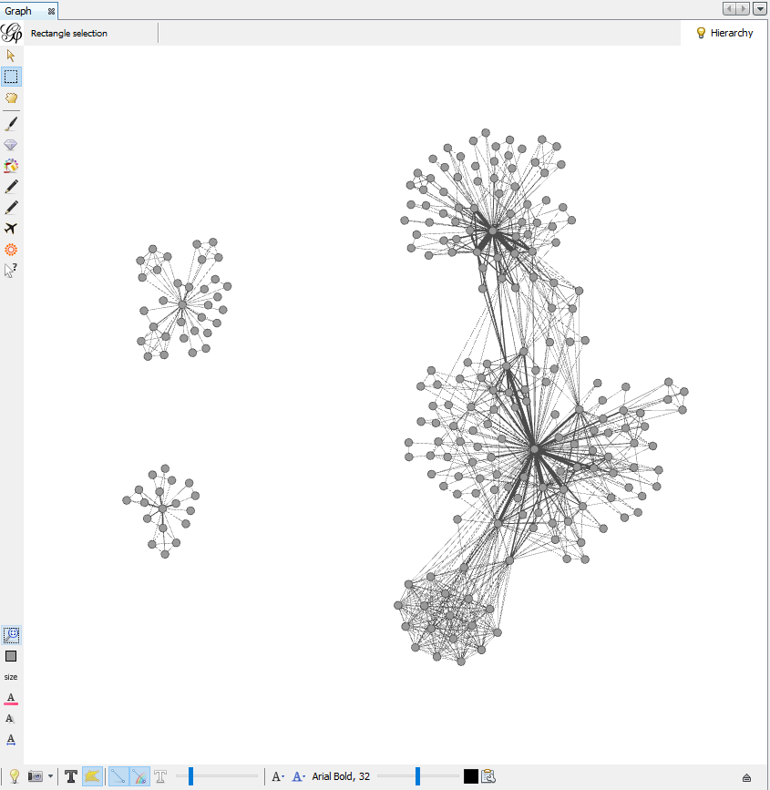
Gephi: Initial Layout of Network

Slide 50
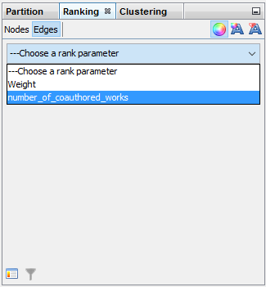
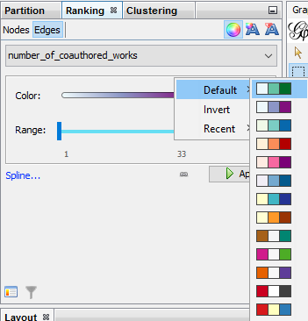
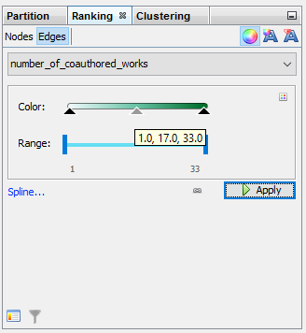
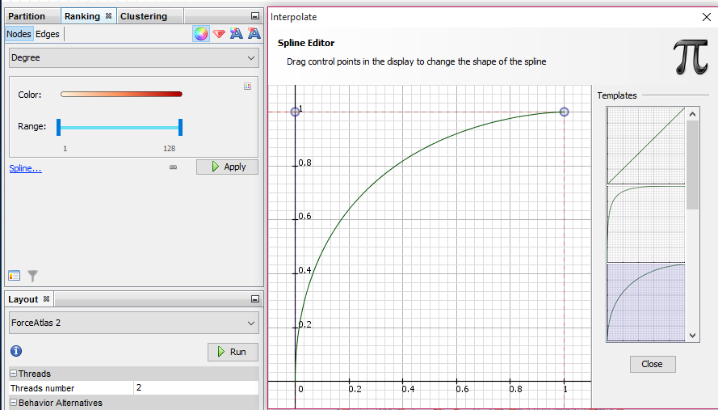
Gephi: Edge Color
Next, we can adjust the edge color by selecting the Edge tab in the Ranking window.
In the drop down menu, select “number_of_coauthored_works”.
Select the small square in the right corner of the Color Range box. This lets us choose new color ranges for variables.
You may also set the color range and values to apply the colors to, or adjust color scaling variables by adjusting the spline.

Slide 51
Gephi: Network statistics
Gephi provides a variety of node and edge statistics to help understand the relationships, clustering, paths, centrality, and communities within a network.
Try implementing the Average Degree, and Network Diameter statistics, which we will next visualize.

Slide 52
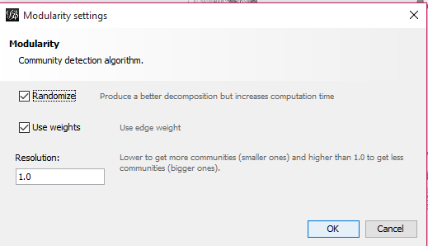
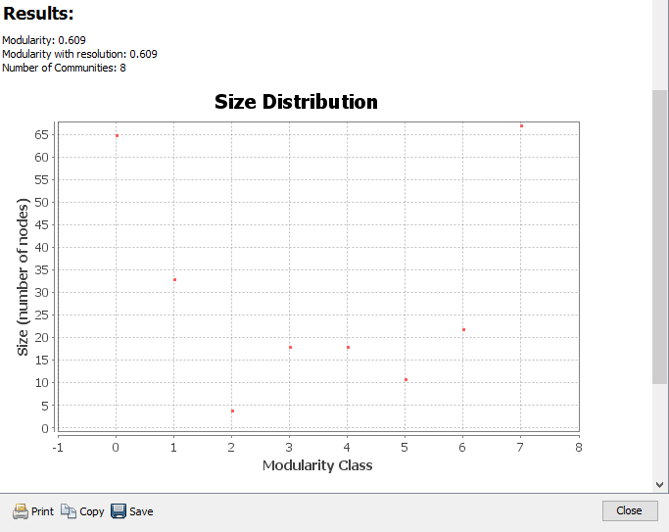
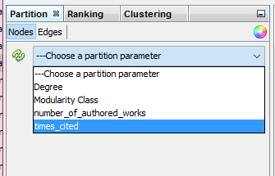
Gephi: Network statistics/Community Detection
The modularity statistical algorithm calculates how the connectedness of a network, and the Blondel Communities that exist in the network. The communities are added as a partition to the nodes.
The modularity categories may be applied to the network from the Partitions window.

Slide 53
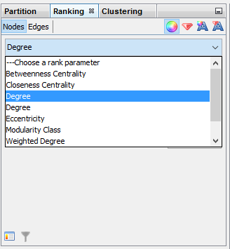
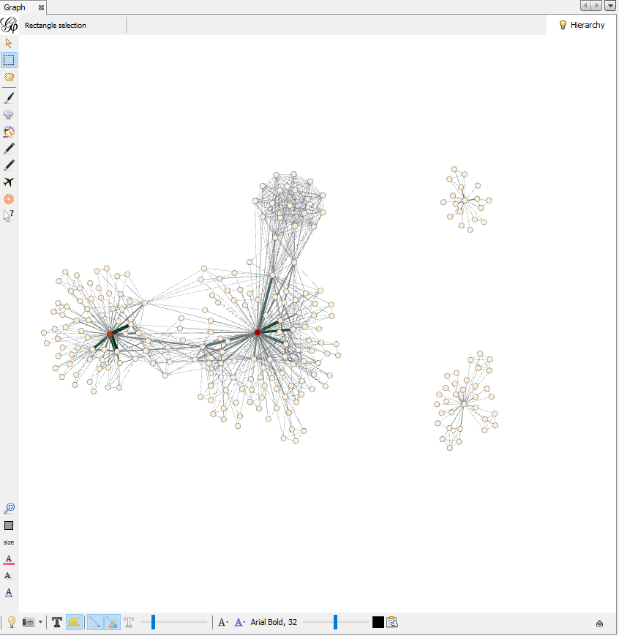
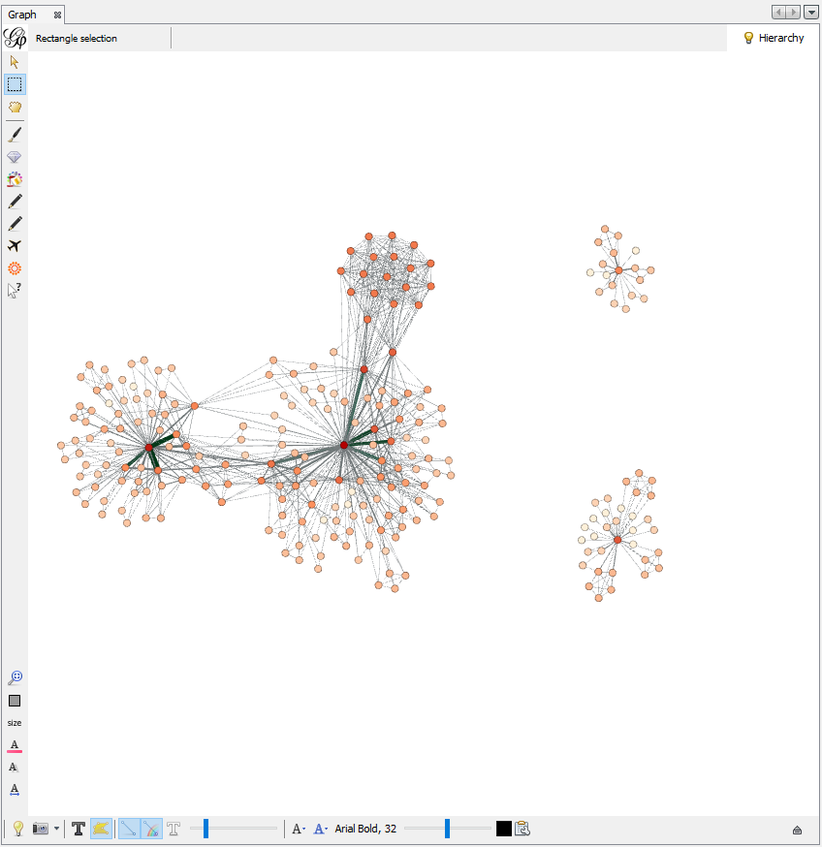
Gephi: Node Color Ranking & Scaling – Degree & Times Cited

Slide 54
Gephi: Node Color Ranking & Scaling – Betweenness Centrality

Slide 55
Gephi: Node Labels – Data Laboratory

Slide 56
Gephi: Node Labels – Overview

Slide 57
Gephi: Node Labels – Overview

Slide 58
Gephi: Final visualization – Node Parameters

Slide 59
Gephi: Final visualization – Node Parameters

Slide 60
Gephi: Final visualization – Edge Color Parameters

Slide 61
Gephi: Label Adjustments
Layout algorithm
Manual adjustments

Slide 62
Gephi: Exporting the visualization and networks

Slide 63
Gephi: Exporting the visualization and networks

